Slide 1
Liquidity, liquidity everywhere, not a drop to use
Why flooding banks with central bank reserves may not expand liquidity
Viral V Acharya (NYU Stern) and Raghuram G Rajan (Chicago Booth)
May 2023

Slide 2
Conundrum: Where did all the liquidity go?
Unprecedented expansion of central bank balance sheets since 2008
  Central banks issue reserves (central bank liability) to commercial banks (commercial bank asset) while buying bonds
    Most liquid asset on planet.
Yet…
Surprisingly fragile liquidity conditions in money markets
  Unexpectedly large spikes in repo markets in September 2019
  Dash for cash in March 2020
  UK Gilts: LDI (pension) crisis following the “mini budget” in October 2022
  Uninsured depositor runs based on bank solvency concerns in March 2023
Why?

Slide 3
How does the Fed expand its balance sheet?
Till recently, only commercial banks held reserves
Fed buys securities, pays with reserves (Fed money).
  From public
  From commercial bank

Slide 4
QE: Buying from public, expansion of bank balance sheet
Initial Balance Sheet Conditions
After Purchase
FEDERAL RESERVE
Assets | Liabilities
Treasury securities | Reserves held by banks Cash held by the Treasury
Expansion financed with bank deposits
FEDERAL RESERVE
Assets | Liabilities
Treasury securities +$1 | Reserves held by banks +$1 Cash held by the Treasury
BANKING SECTOR
Assets | Liabilities
Treasury securities Reserves at the Fed | Deposits
PUBLIC
Assets | Liabilities
Deposits Treasury securities | Wealth
BANKING SECTOR
Assets | Liabilities
Treasury securities Reserves at the Fed +$1 | Deposits +$1
PUBLIC
Assets | Liabilities
Deposits +$1 Treasury securities -$1 | Wealth
Source: “How the Fed Changes the Size of its Balance Sheet” (Leonard, Martin and Potter, Liberty Street Economics, 2017)
Notes:
In the second way that the asset swap can take place, the non-bank sector (say the public) sells eligible assets to the central bank. The payment is deposited in commercial banks; banks add reserves to their assets and these are effectively “financed” by deposits of the non-bank financial sector that engaged in asset swap with the Fed.
Without any indirect or multiplier effects via the bank balance-sheet, there is a one for one expansion of banking sector balance-sheet with reserves. Importantly, its deposits, which typically are wholesale demandable deposits, expand with reserves.
Given these different ways that Fed expansion of balance-sheet affects the banking sector, the following questions arise:
How does Fed balance-sheet expansion affect the size and demandable deposit base of the banking sector?
Do other demandable liabilities issued by banks also grow because of the availability of reserves?
If banking sector liabilities grow, do they reverse via the same mechanism when the Fed shrinks its balance-sheet?

Slide 5
QE: Buying from bank, no expansion of bank balance sheet
Initial Balance Sheet Conditions
After purchase
FEDERAL RESERVE
Assets | Liabilities
Treasury securities | Reserves held by banks Cash held by the Treasury
FEDERAL RESERVE
Assets | Liabilities
Treasury securities +$1 | Reserves held by banks +$1 Cash held by the Treasury
Asset
swap
with banks
BANKING SECTOR
Assets | Liabilities
Treasury securities Reserves at the Fed | Deposits
BANKING SECTOR
Assets | Liabilities
Treasury securities -$1 Reserves at the Fed +$1 | Deposits
Source: “How the Fed Changes the Size of its Balance Sheet” (Leonard, Martin and Potter, Liberty Street Economics, 2017)
Notes:
At the cost of repeating what is already known to this audience, let me – in the interest of setting a common stage – walk through the process via which a central bank such as the Fed expands its balance-sheet.
The Fed swaps assets such as Treasury securities or Agency-backed securities for reserves. Typically, the reserves sit on commercial bank balance-sheets. The asset swap, however, may happen in two ways.
One, the asset swap can happen directly with banks as shown on slide 2. In this case, banks swap eligible securities for central bank reserves, and the process of Fed injecting reserves directly does not lead to a growth of bank deposits.
It does, however, typically lead to a shortening of the duration of bank assets, which may require it rebalancing liabilities, which we don’t explore here but will revisit later.

Slide 6
Three considerations in whether past CB balance sheet expansion could create liquidity stress.
Ex ante: How are the reserves financed?
  Central bank buys bonds from public, creates reserves deposited in commercial banks.
  Are reserves financed with deposits or do banks rebalance deposits with new capital issuances?
  The way reserves are financed matters as demand deposits will be a claim on reserves in future

Slide 7
Three considerations…
Ex post: Shrinkage and/or Additional encumbrances on reserves
  Quantitative Tightening (QT) shrinks reserves but need not shrink liquidity claims
    Acharya, Chauhan, Rajan and Steffen (2002)
    Equivalent to QT being an asset-swap with banks (QE being asset-swap with non-banks)
  Commercial banks reluctant to leave reserves idle – therefore sell contingent claims on liquidity so that reserves are “fully” utilized.
    Bank credit lines
    Back up guarantees to speculators: Margin calls, central clearing guarantee funds, etc.,
  Regulation: liquidity requirements “lock up” reserves in stress scenarios (Diamond and Kashyap, 2016; Vandeweyer, 2019; others)
  Ratcheting: the level of reserves creates own supervisory demand (Nelson, 2019)

Slide 8
Three considerations…
III. Ex post: Will banks with free reserves lend them out?
  High rate paid in the interbank market for reserves when the system is stressed.
  However, some surplus banks fear a “taint” from lending to needy.
  Instead prefer to stay “safe” and receive flight-to-safety deposits passively.
  => Liquidity hoarding limits the ex-post availability of reserves.

Slide 9
Where we are going…
Central bank reserve expansion works through commercial bank balance sheets.
Ordinarily, far less spare liquidity than suggested by simple reserve expansion.
In extremis, higher the reserves issued ex ante, more fragile the interbank markets and higher the inter-bank rates in stress
Adverse real consequences on corporate investments

Slide 10
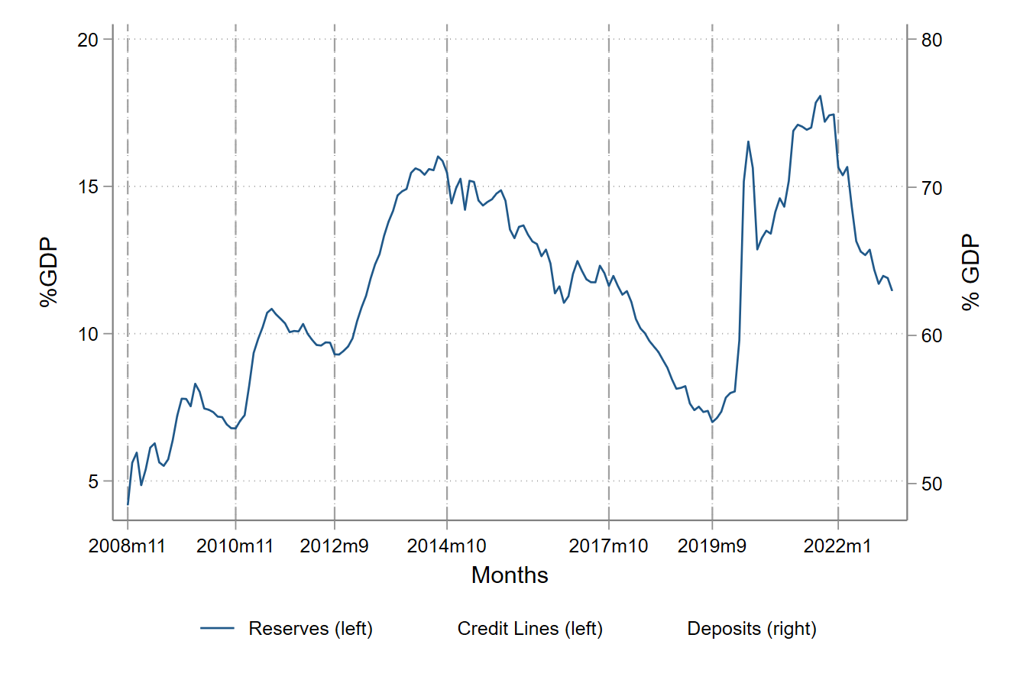
Reserves and Claims (% of GDP)
QE I
QE II
QE III
Post-QE
QT I
Pandemic QE
QT II
Notes:
The blue line is reserves to GDP (on the left axis), the red line is outstanding bank credit lines to GDP (also on the left axis) and green line is bank deposits to GDP (on the right axis, as it tends to be far greater). Data are from the Federal Reserve’s Flow of Funds for the 2008 to 2021 period.
The vertical lines correspond to the beginning of the different Federal Reserve Quantitative Easing (QE) / Quantitative Tightening (QT) programs: (1) Nov 2008 (QE I), (2) Nov 2010 (QE II), (3) Nov 2012 (QE III), (4) Oct 2014 (QE halted without actively reducing balance sheet size), (5) October 2017 (Quantitative Tightening or active balance sheet reduction), and (6) Sept 2019 (Repo-market “spike” and liquidity infusion, followed by Pandemic-induced QE starting March 2020, which for simplicity we collectively refer to as “Pandemic QE”).
Key patterns that emerge are as follows:
Central bank reserves expanded from the start of QE I in November 2008 to the end of QE III in Sep 2014 from less than 5% of GDP to more than 15% of GDP. There is some stabilization, even decline, in reserves when each phase of QE ended and before the next phase began.
At the same time, bank deposits grew from about 50% to 60% of GDP, again with some stabilization when each phase of QE ended and before the next one began.
While the increase in credit lines was less pronounced at first, they too increased from November 2010 (the start of the QE II) from about 12% to over 15% of GDP by Sep 2014.
Importantly, while reserves dropped by more than half after QE was halted in Oct 2014 and
during the first QT period until September 2019, both credit lines, as well as deposits, remained remarkably flat. This highlights the pattern that neither of these claims on bank liquidity reversed their QE I-III increase when the central bank balance sheet shrank.
However, when reserves increased from about 7% to more than 17% of GDP during the pandemic QE period, bank deposits jumped again from 60% to almost 80% of GDP and credit lines also increased to about 17% of GDP.
In other words, this descriptive evidence already highlights the asymmetric effect of an expansion vis-à-vis shrinkage of the central bank balance sheet on commercial bank demandable claims. Notably, the pandemic QE has caused banking sector liabilities to rise again… past suggests no guarantee that these liabilities will shrink when Fed begins to shrink its balance-sheet.
Now turn to slide 1.2 to see this point more sharply.

Slide 11
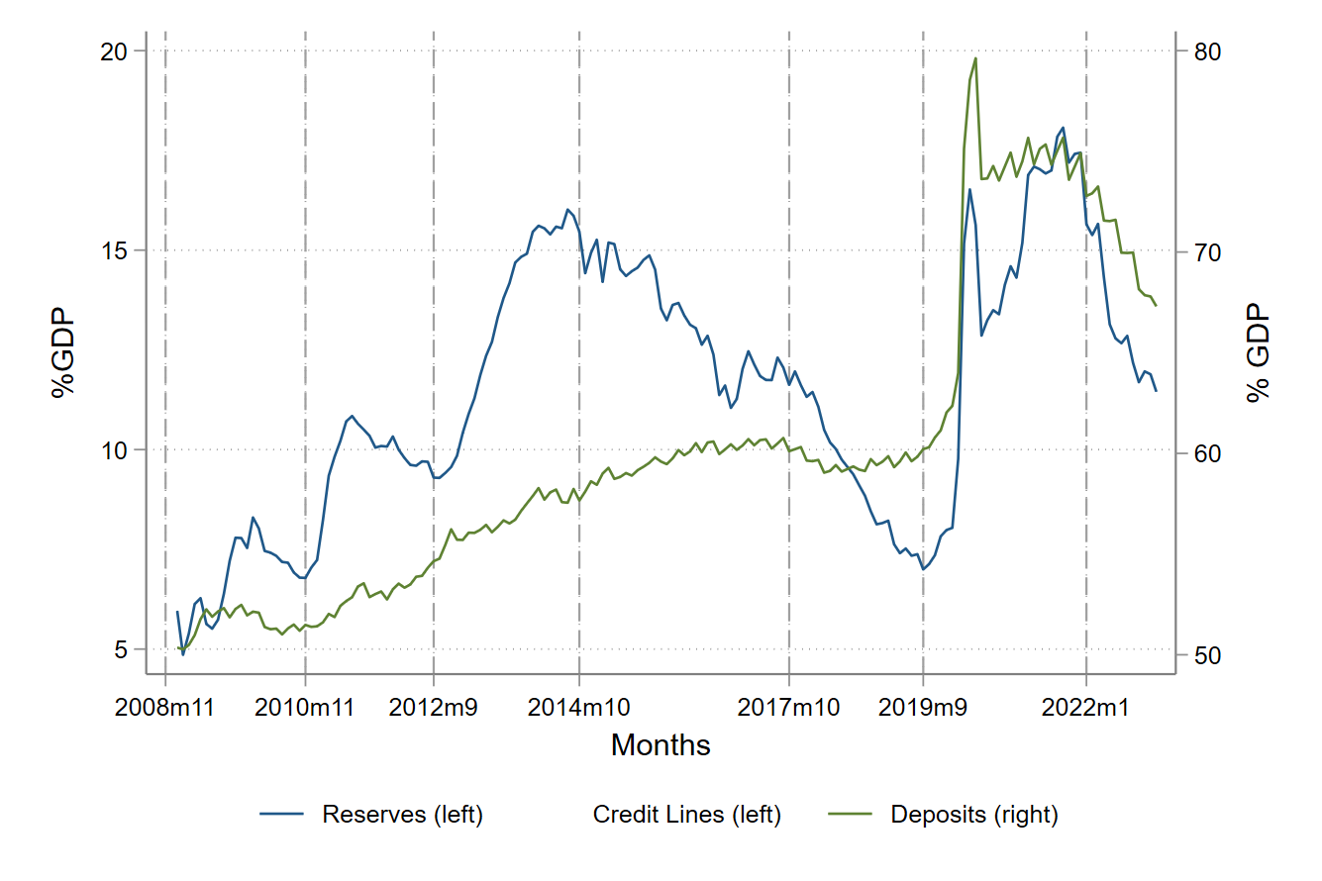
Reserves and Claims (% of GDP)
QE I
QE II
QE III
Post-QE
QT I
Pandemic QE
QT II
Notes:
The blue line is reserves to GDP (on the left axis), the red line is outstanding bank credit lines to GDP (also on the left axis) and green line is bank deposits to GDP (on the right axis, as it tends to be far greater). Data are from the Federal Reserve’s Flow of Funds for the 2008 to 2021 period.
The vertical lines correspond to the beginning of the different Federal Reserve Quantitative Easing (QE) / Quantitative Tightening (QT) programs: (1) Nov 2008 (QE I), (2) Nov 2010 (QE II), (3) Nov 2012 (QE III), (4) Oct 2014 (QE halted without actively reducing balance sheet size), (5) October 2017 (Quantitative Tightening or active balance sheet reduction), and (6) Sept 2019 (Repo-market “spike” and liquidity infusion, followed by Pandemic-induced QE starting March 2020, which for simplicity we collectively refer to as “Pandemic QE”).
Key patterns that emerge are as follows:
Central bank reserves expanded from the start of QE I in November 2008 to the end of QE III in Sep 2014 from less than 5% of GDP to more than 15% of GDP. There is some stabilization, even decline, in reserves when each phase of QE ended and before the next phase began.
At the same time, bank deposits grew from about 50% to 60% of GDP, again with some stabilization when each phase of QE ended and before the next one began.
While the increase in credit lines was less pronounced at first, they too increased from November 2010 (the start of the QE II) from about 12% to over 15% of GDP by Sep 2014.
Importantly, while reserves dropped by more than half after QE was halted in Oct 2014 and
during the first QT period until September 2019, both credit lines, as well as deposits, remained remarkably flat. This highlights the pattern that neither of these claims on bank liquidity reversed their QE I-III increase when the central bank balance sheet shrank.
However, when reserves increased from about 7% to more than 17% of GDP during the pandemic QE period, bank deposits jumped again from 60% to almost 80% of GDP and credit lines also increased to about 17% of GDP.
In other words, this descriptive evidence already highlights the asymmetric effect of an expansion vis-à-vis shrinkage of the central bank balance sheet on commercial bank demandable claims. Notably, the pandemic QE has caused banking sector liabilities to rise again… past suggests no guarantee that these liabilities will shrink when Fed begins to shrink its balance-sheet.
Now turn to slide 1.2 to see this point more sharply.

Slide 12
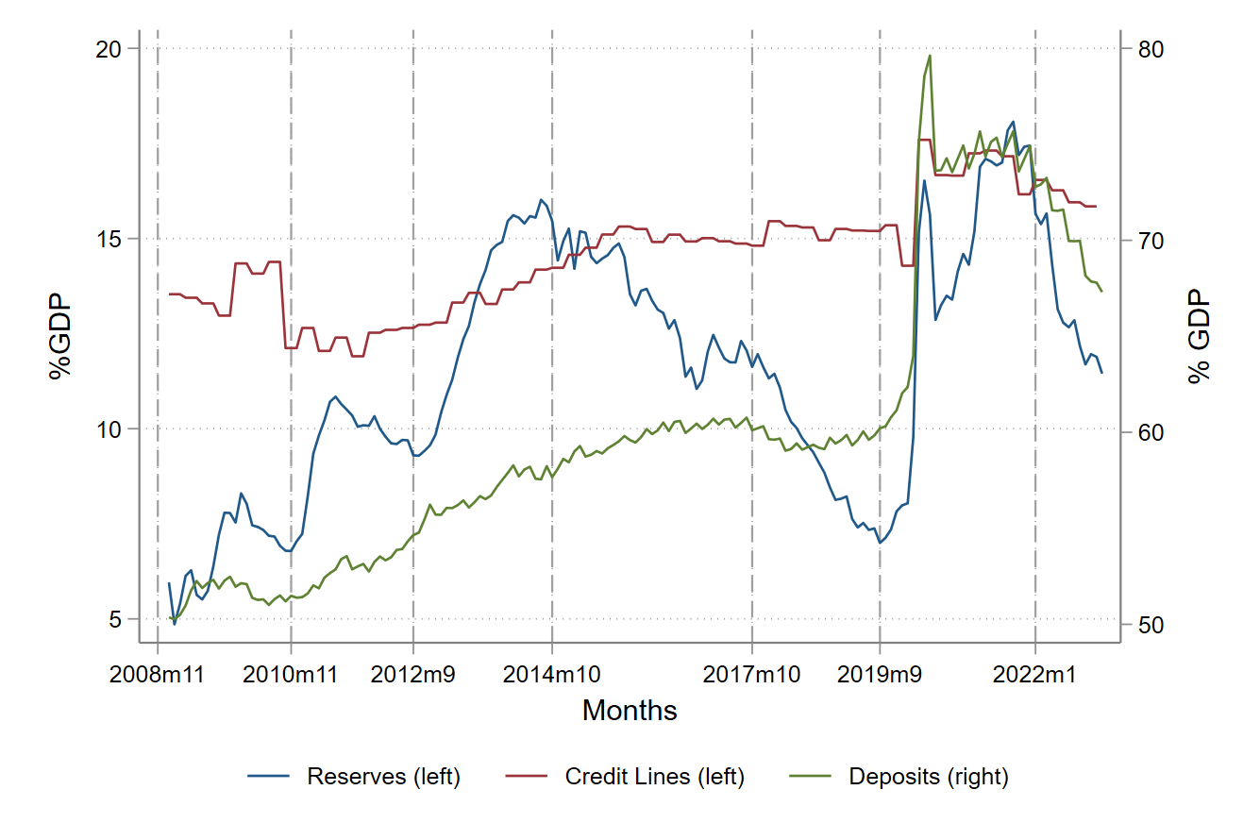
Reserves and Claims (% of GDP)
QE I
QE II
QE III
Post-QE
QT I
Pandemic QE
QT II
Notes:
The blue line is reserves to GDP (on the left axis), the red line is outstanding bank credit lines to GDP (also on the left axis) and green line is bank deposits to GDP (on the right axis, as it tends to be far greater). Data are from the Federal Reserve’s Flow of Funds for the 2008 to 2021 period.
The vertical lines correspond to the beginning of the different Federal Reserve Quantitative Easing (QE) / Quantitative Tightening (QT) programs: (1) Nov 2008 (QE I), (2) Nov 2010 (QE II), (3) Nov 2012 (QE III), (4) Oct 2014 (QE halted without actively reducing balance sheet size), (5) October 2017 (Quantitative Tightening or active balance sheet reduction), and (6) Sept 2019 (Repo-market “spike” and liquidity infusion, followed by Pandemic-induced QE starting March 2020, which for simplicity we collectively refer to as “Pandemic QE”).
Key patterns that emerge are as follows:
Central bank reserves expanded from the start of QE I in November 2008 to the end of QE III in Sep 2014 from less than 5% of GDP to more than 15% of GDP. There is some stabilization, even decline, in reserves when each phase of QE ended and before the next phase began.
At the same time, bank deposits grew from about 50% to 60% of GDP, again with some stabilization when each phase of QE ended and before the next one began.
While the increase in credit lines was less pronounced at first, they too increased from November 2010 (the start of the QE II) from about 12% to over 15% of GDP by Sep 2014.
Importantly, while reserves dropped by more than half after QE was halted in Oct 2014 and
during the first QT period until September 2019, both credit lines, as well as deposits, remained remarkably flat. This highlights the pattern that neither of these claims on bank liquidity reversed their QE I-III increase when the central bank balance sheet shrank.
However, when reserves increased from about 7% to more than 17% of GDP during the pandemic QE period, bank deposits jumped again from 60% to almost 80% of GDP and credit lines also increased to about 17% of GDP.
In other words, this descriptive evidence already highlights the asymmetric effect of an expansion vis-à-vis shrinkage of the central bank balance sheet on commercial bank demandable claims. Notably, the pandemic QE has caused banking sector liabilities to rise again… past suggests no guarantee that these liabilities will shrink when Fed begins to shrink its balance-sheet.
Now turn to slide 1.2 to see this point more sharply.

Slide 13
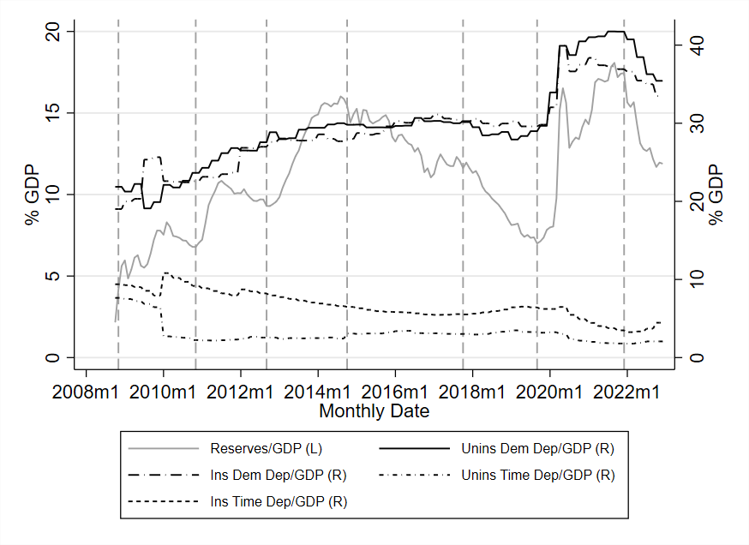
Uninsured/Insured Demandable/Time Deposits (Prop. of GDP)
QE I
QE II
QE III
Post-QE
Pandemic QE
QT I
QT II
Notes:
The blue line in this figure are time deposits (CDs), the red line is demand deposits (checking, savings, money-market savings, etc.), and green line is the aggregate reserves. All are plotted relative to GDP.
By decomposing deposits into time deposits and non-time or demandable deposits we see that time deposits shrink substantially during QE, stabilize some during post-QE and even rise during QT, whereas demand deposits rise more than one for one during QE, keep growing post-QE, and come down relative to GDP only marginally so during QT.
In the paper, we show that these effects are driven almost entirely by the uninsured portion of deposits.
Maturity-shortening of bank deposits is thus another dimension of liquidity dependence induced by QE, which makes QT potentially an uphill task.

Slide 14
The Basic Model
Firms, Banks, Investors, … Interbank market to shuffle around liquidity

Slide 15
Model: Firms, Banks, Depositors, Investors
Bank firm pairs
  “regionally” or “sectorally” matched
Firm and bank owners are risk-neutral, expected profit-maximizers
Firms:
  Invest at date 0 to obtain returns at date 2 , funded by
    Firm owners’ initial wealth W
    Term loans from banks L
  - Place deposits with bank.

Slide 16
Firms, Banks, Depositors, Investors
Banks at date 0:
  Assets
    Long term loan to their firm
    Liquid reserves shrink by encumbrance τ at date 1
  Liabilities I: Uninsured deposits from risk-averse investors at date 0
    Will run if firm/bank stressed at date 1
  Liabilities II: Capital from deep-pocket risk-neutral investors
  [ or alternatively, costly-to-raise “core” deposits that do not run ]
    Stable but costly capital funding available at date t
    Quadratic costs

Slide 17
Liquidity stress in the economy
Economy stressed with probability q / θ, healthy otherwise.
Conditional on economy stress, probability θ that specific bank-firm pair’s investment is stressed and has to be “rescued” with additional investment

Slide 18
Healthy firm/bank
Healthy Economy
1
Healthy firm/bank
Healthy Bank
Bank-firm pairs, date-0 investment
Liquidity stressed
Economy
Inter-bank
market
Stressed
Firm, Rescue Investment
Stressed Bank
Date 0
Date 1

Slide 19
Stressed firm/bank at date 1
If bank-firm pair stressed
  Firm will withdraw deposit and ask for additional loan to fund its optimal date-1 “rescue” investment.
  Risk averse depositors will run.
Stressed banks will raise funding
  (1) From the date-1 inter-bank market at rate .
  (2) They also can raise date-1 capital

Slide 20
Healthy bank behavior at date 1
Only a fraction of healthy banks lend to stressed banks in the inter-bank market.
Remaining fear being tainted: (1 - ) “safe” healthy banks
  forego lending
  but being seen as safe, receive flight-to-safety deposits that run from stressed banks.
fixed for now

Slide 21
Healthy firm/Bank
Healthy Economy
1
Liquidity
Hoarding
Fraction
Healthy firm/Bank
Safe Bank
Bank-firm pairs, date-0 investment
Liquidity stressed
Economy
Flight
To
Safety
Fraction
Tainted Bank
Stressed
Firm, Rescue Investment
Inter-bank
market
Stressed Bank
Date 0
Date 1

Slide 22
Firm’s problem
Date 0:
Date 1:
Budget constraints:
Term
loan
Spot
loan
Rescue investment

Slide 23
Bank’s problem
if stressed bank
if tainted bank

Slide 24
Conditional on liquidity stress in the economy.
The market for spot loans clears at date 1 at .
Stressed and tainted banks issue capital at marginal cost . Since banks will not issue at a higher cost than , it must be that
Increases one for one with
Additional
liquidity raised
via date-1 capital
issuances
Firm’s fund
requirement
for rescue
investment
Risk averse
depositor
run
Unencumbered
liquidity with
stressed and tainted banks

Slide 25
When do more ex ante reserves increase ex post stress?
How does rate change with ?
Additional dollar of reserves creates demand for liquidity from stressed banks
Creates supply of liquidity

Slide 26
Ex-ante reserves and degree of ex-post stress
Rearranging, more ex-ante reserves enhance liquidity stress if
If the inter-bank market is shut ( ), the date-1 shadow inter-bank rate always increases in ex-ante reserves if .
If inter-bank market fully open ( ), then the shadow interbank rate increases whenever

Slide 27
To recap…
Central bank reserve expansion works through commercial bank balance sheets.
Ordinarily, far less spare liquidity than suggested by simple reserve expansion.
In extremis, higher the reserves issued ex ante, more fragile the interbank markets and higher the inter-bank rates in stress
This can have adverse real consequences on corporate investments

Slide 28
Extensions
Endogenize , the extent of hoarding by introducing a small but positive convenience yield on reserves.
Endogenize , the shrinkage of reserves
Interesting result: the date-1 interbank market can shut down under a variety of circumstances.

Slide 29
I. Endogenizing hoarding and lending
Deposits fleeing distressed banks migrate to “safe” banks
Let safe banks earn a (small) convenience yield on reserves
  - value of liquidity in case of additional stress
To be perceived as “safe” and attract deposits, healthy banks must not get “tainted” by lending to stressed banks.
But they then forego the return from lending in the interbank market.
Equilibrium fraction of banks that lend in the interbank market
  equates profits from lending to profits from receiving flight to safety deposits

Slide 30
Breakeven rate for inter-bank market to open up
“Tainted” Bank
value
“Safe” Bank
value
Breakeven
Inter-bank rate
For (some) Surplus
Banks To Lend

Slide 31
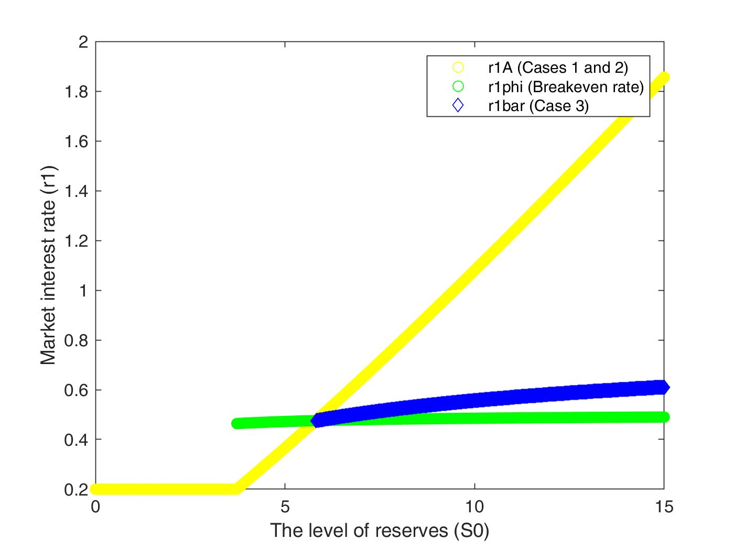
Interbank rate increases enough
to open the inter-bank market
Autarky
(inter-bank
market
endogenously shut)

Slide 32
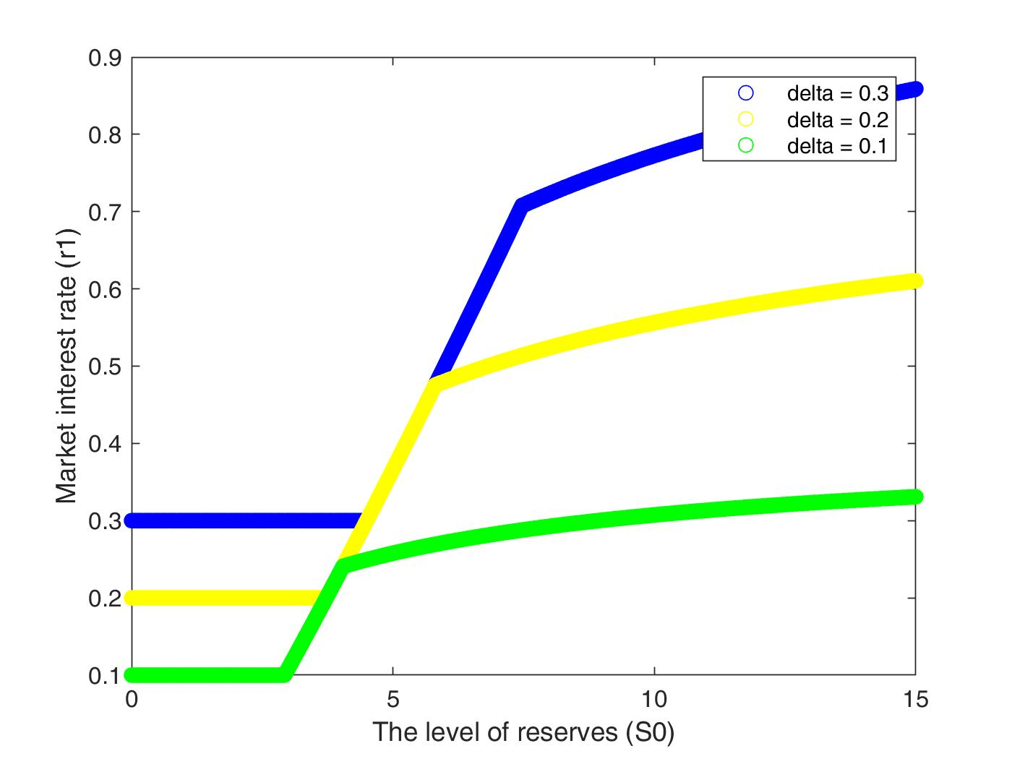

Slide 33
Implications
The greater the perceived benefit of reserves hoarding during stress, the more likely it is that higher ex ante reserves lead to financial fragility
Endogenous ( ) may imply the interbank market never opens.

Slide 34
Endogenize reserve shrinkage : QT
Suppose QT consists of the central bank selling securities
Assume this takes place before uncertainty is realized.
The central bank can sell securities
  To banks : Asset swap
    This will shrink bank reserves, without shrinking bank deposits.
  To the public
    This will shrink bank reserves and deposits
In 2017-19, largely seemed to be asset swap

Slide 35
QT: Asset swap with banks, no contraction of deposits
Initial Balance Sheet Conditions
After purchase
FEDERAL RESERVE
Assets | Liabilities
Treasury securities | Reserves held by banks Cash held by the Treasury
FEDERAL RESERVE
Assets | Liabilities
Treasury securities -$1 | Reserves held by banks -$1 Cash held by the Treasury
Asset
swap
with banks
BANKING SECTOR
Assets | Liabilities
Treasury securities Reserves at the Fed | Deposits
BANKING SECTOR
Assets | Liabilities
Treasury securities +$1 Reserves at the Fed -$1 | Deposits
Source: “How the Fed Changes the Size of its Balance Sheet” (Leonard, Martin and Potter, Liberty Street Economics, 2017)
Notes:
At the cost of repeating what is already known to this audience, let me – in the interest of setting a common stage – walk through the process via which a central bank such as the Fed expands its balance-sheet.
The Fed swaps assets such as Treasury securities or Agency-backed securities for reserves. Typically, the reserves sit on commercial bank balance-sheets. The asset swap, however, may happen in two ways.
One, the asset swap can happen directly with banks as shown on slide 2. In this case, banks swap eligible securities for central bank reserves, and the process of Fed injecting reserves directly does not lead to a growth of bank deposits.
It does, however, typically lead to a shortening of the duration of bank assets, which may require it rebalancing liabilities, which we don’t explore here but will revisit later.

Slide 36
Why might QT take this form?
Central bank wants to sell securities
Bank is prime broker with public clients holding deposits in bank.
  Bank balance sheet contraction as clients pay for securities with their deposits
Or it can buy securities itself.
  Asset swap
Assume securities are not as liquid as reserves, but can be “repoed” for reserves in a stressed market at a haircut h.

Slide 37
Will the bank buy CB securities itself or sell to clients
In stressed state
If a bank stressed,
  Balance sheet contraction: It gave up $1 of reserves for $1 of deposit shrinkage
  Asset swap: repo the security for (1-h) of reserves, but have to pay 1 to deposits
  It is always better off having contracted its balance sheet.
If a bank healthy and wants to lend in interbank
  Balance sheet contraction: It gave up $1 of reserves which it cannot lend
  Asset swap: It has (1-h) of repoed reserves which it can lend in the interbank market.
  Prefers asset swap
Ex ante, if small, high, and h small, asset swap dominates.
=> Reserve shrinkage relative to deposits high.

Slide 38
Policy Considerations
Liquidity concerns would imply the central bank should set reserves such that
But un-modeled monetary policy concerns in an era of too-low inflation might require setting reserves at a different level (QE).
Divergence between concerns most likely when degree of liquidity stress rises in ex-ante reserves.
If so, ex post liquidity stress will offset some of the beneficial effects of monetary policy when reserves are set too high from a liquidity perspective.
Would capital requirements help?
  No, when exogenous, private and social choice in capital structure coincide since we have only a pecuniary externality (unlike Lorenzoni (2008) or Stein (2012)).
  With endogenous, social planner wants to set capital lower!

Slide 39
Qualifies other policy recommendations
Would more ex ante central bank balance-sheet expansion (Copeland, Duffie and Yang, 2021) work to alleviate ex post liquidity stress?
  Under certain conditions could be a moving target!
Would reserve issuance crowd out deposit-like claims (Greenwood, Hanson and Stein (2015, 2016))?
  Our base model says it would enhance them.
  Requires reserves to be held by non banks (e.g., money market funds).

Slide 40
Cannot the central bank intervene ex post?
Yes but
Crowds out private ex-post lending by surplus banks – more hoarding
Central banks typically lend against collateral
  High quality collateral financed with deposits does not add additional liquidity
Unsecured interventions or lending against all manner of assets (March 2023)
  In principle, can solve all liquidity problems, BUT… typically distort asset prices and has fiscal component: moral hazard
Ex-ante moral hazard
    Acharya, Shin and Yorulmazer (2011), Diamond and Rajan (2012), Farhi and Tirole (2011)
Ratcheting intervention: liquidity dependence.

Slide 41
Traditional view: Exogenous demand for liquidity
Supply of Reserves
Price of Liquidity = vs.
Exogenous demand for liquidity
As demand is exogenous, increasing supply of reserves is stabilizing

Slide 42
Our point: Liquidity demand is affected by reserves
Supply of Reserves
Price of Liquidity = vs.
Deposits + New Liquidity claims
Supply of reserves creates its own demand, new claims, which can destabilize

Slide 43
Conclusion
Large central bank balance sheet need not imply the financial system has plenty of spare liquidity.
Supply of ex-ante reserves creates its own ex-post demand
Limits the central bank’s ability to use an expanded balance-sheet to enhance stability or growth
Take care when you shrink the central bank balance sheet: hysteresis.
- Engage in QT while “feeling the stones” for financial fragility
- Monitor claims on liquidity also to see if they shrink.
- Alternative: Target QT as sales to non-banks?
Revisit desirable scale, scope, duration of QE: “pushing on a string”?

Slide 44
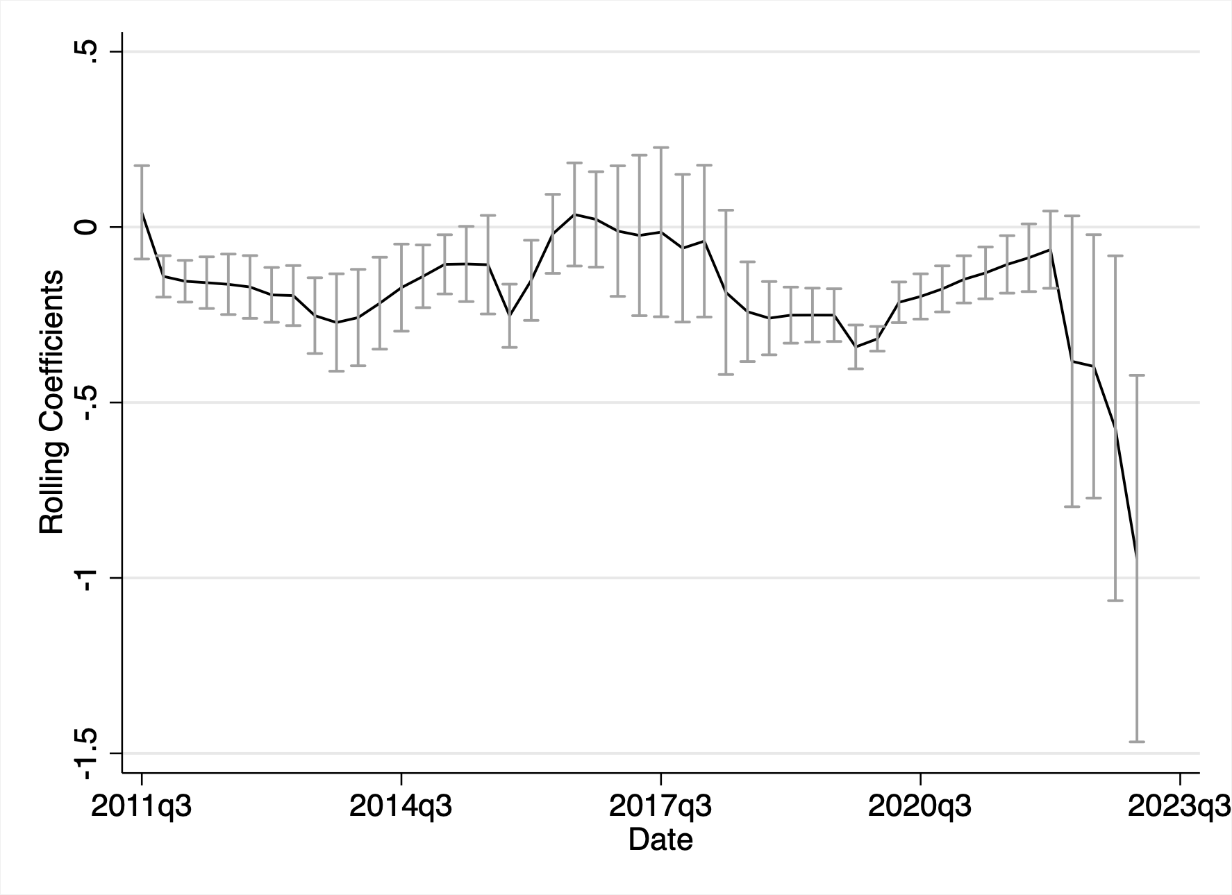
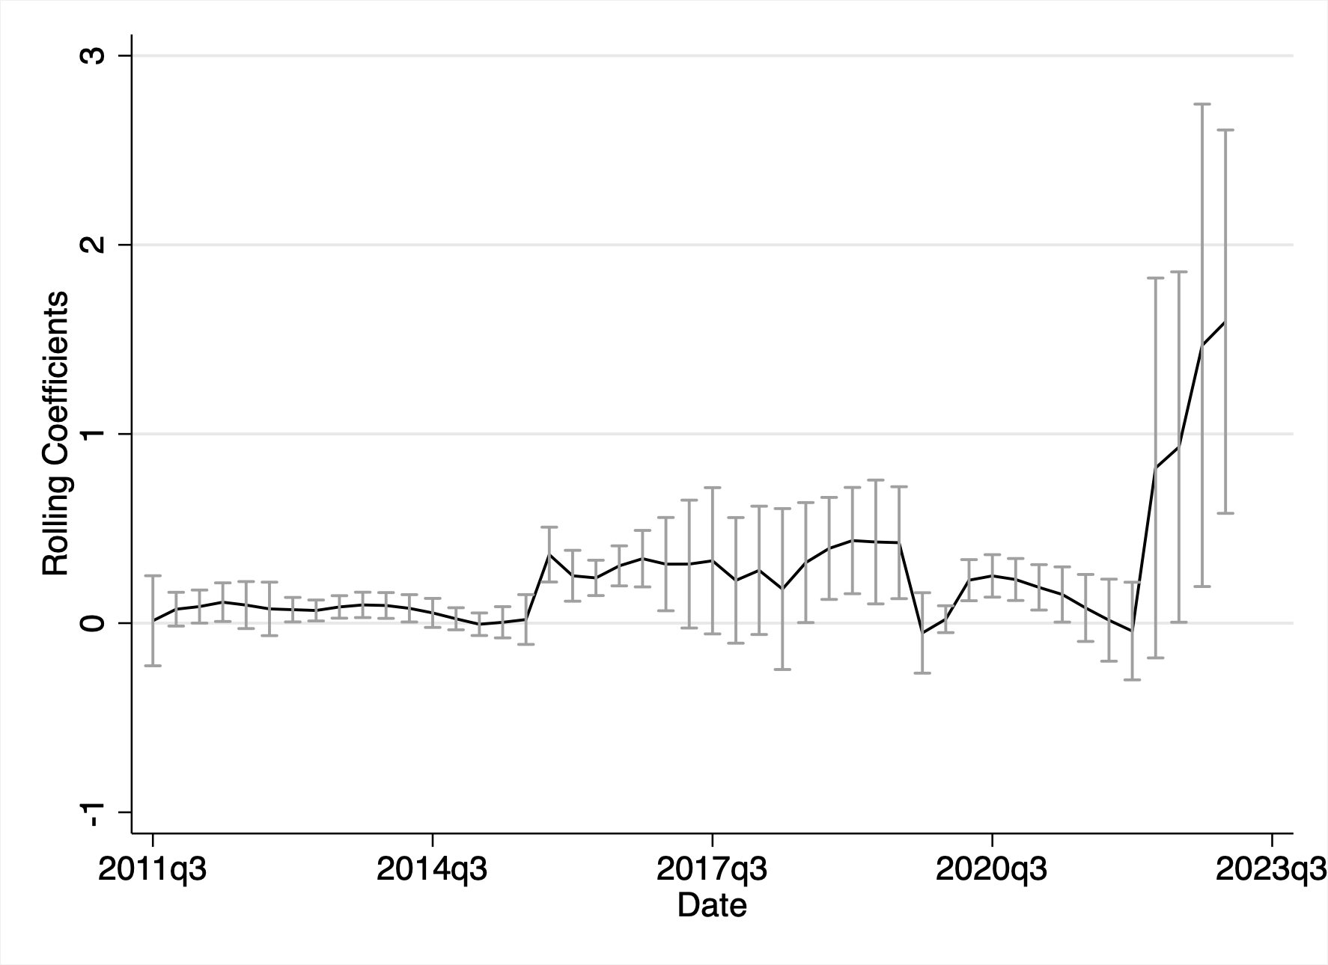
Qtrly Rolling Coefficient of EFFR-IOR on Reserves + UDD
Illiquidity rises during
Active QT (especially pandemic-QT)
by the Fed
Reserves
Uninsured Demandable Deposits

Slide 45
Why would banks engage in asset-swap in QT?
Suppose banks assume that > 0 in the liquidity stressed state
Then banks desire liquid assets in QT (s = 1) if and only if
Likely the case if
Securities are priced low
Expected haircut in LOLR is low
Expected probability of liquidity stress is low
Intuition: Individual banks while managing private liquidity risk, taking as given the aggregate liquidity risk, engender aggregate liquidity risk!

Slide 46
Will run to
“safe” banks if stressed
Rescue
investment
Shrinkage
or unusable
reserves
Liquidity
Demand
at date 1

Slide 47
“Tainted”
Bank
Liquidity
Supply
Available reserves

